Slide 1
Predicting Diabetes-Related Readmission
Team members
CMPE 266 Fall 2018
Ishwarya Varadarajan - 011549473
Priyanka Subramanyam - 012420603
Sahitya Mullapudi - 011545404
Savitri Swapna Maddula - 012551799
Sowmya Viswanathan - 011432668

Slide 2
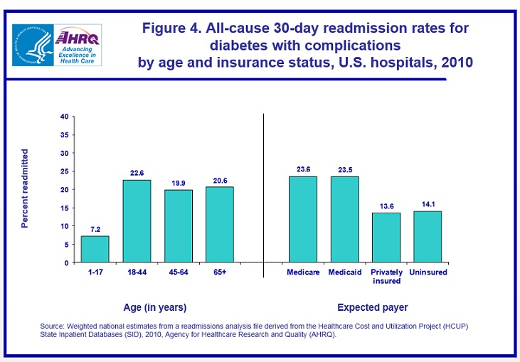
Problem Statement
Readmission is costly, harmful and burdensome to the patient ─ and it is potentially preventable.
Thus, readmission within 30 days is one factor used to rate hospitals on quality of care and determine reimbursement.
Understanding what causes readmissions can lead toward improved patient outcomes and quality of care, and lower costs.

Slide 3
Project Scope
Develop a predictive model for determining patients with different treatments who are most likely to be readmitted after a medical encounter.
If a predictive model can be built which will determine the readmission of patients after a medical encounter, the monetary burden on the health care facilities can considerably reduce, thereby reducing the annual costs estimated/allocated for the hospitals.

Slide 4
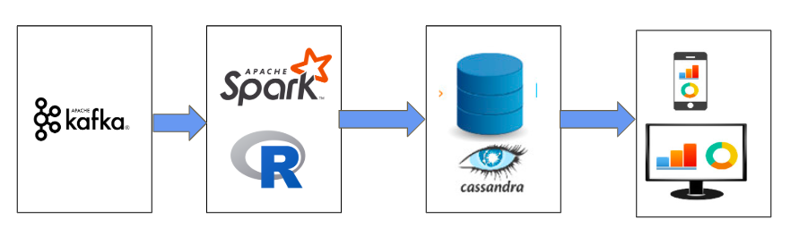
Architecture
Data
Sources
Application of
ML & Visualization
Tools on big-data
Government Agencies
Medical Devices
Hospitals
It is Sensor Data Collected through various medical devices from hospitals

Slide 5
Data
Sourced from UCI Machine Learning Repository
Includes data from 130 US Hospitals
Covers 10 years patient data
Raw Dataset includes - 100000 instances, 50 attributes

Slide 6
WorkFlow
(Scripting Language - R)
Data Preparation → Loading(Cassandra), Cleaning, Processing of data
Model Planning → Plan the model to be used on data based on its statistics
Model Building → Logistic Regression, Decision Tree
Model Evaluation → Various Metrics like ROC, Confusion Matrix, Accuracy etc
Visualising Results → ggplot, ggplot2, Tableau

Slide 7
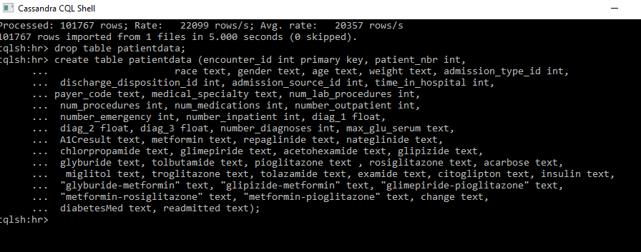
Cassandra

Slide 8
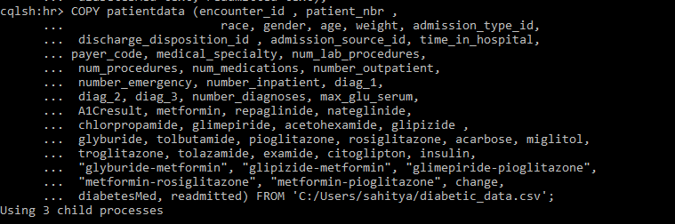
Cassandra

Slide 9
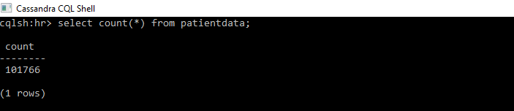
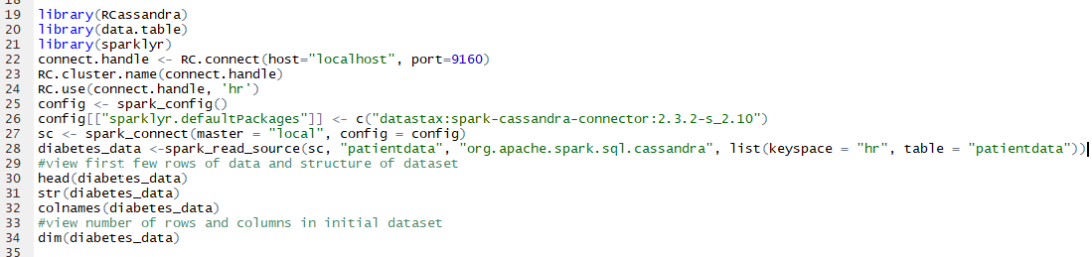
RCassandra

Slide 10
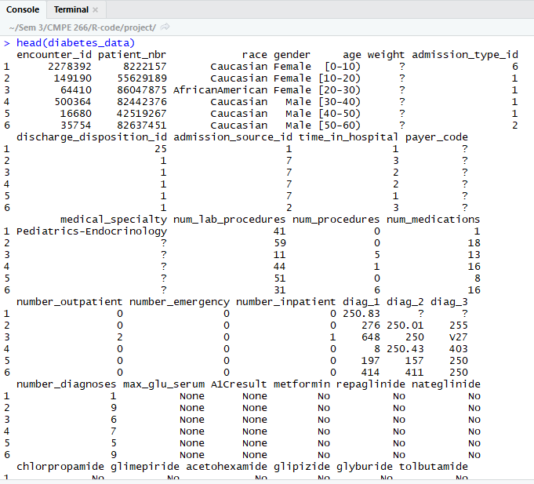
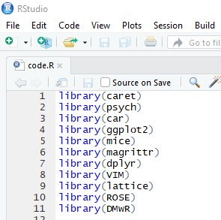
R-Studio Console

Slide 11
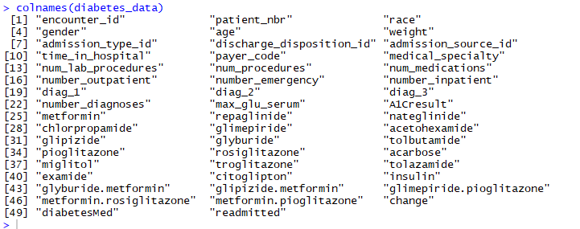
Data Attributes
(R-Studio Console)

Slide 12
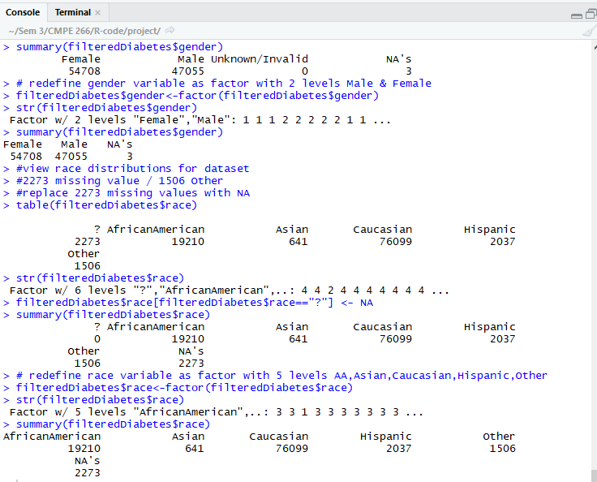
Data Preparation-Categorical Data Processing

Slide 13
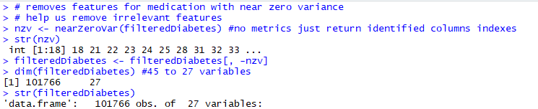
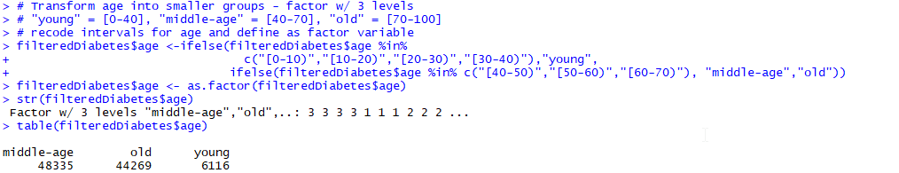
Data Preparation-Remove columns with near zero variance
Convert Continuous variable to levels

Slide 14
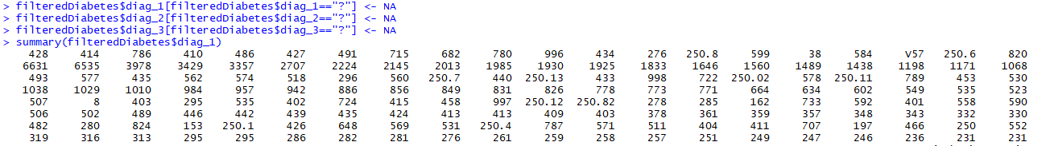
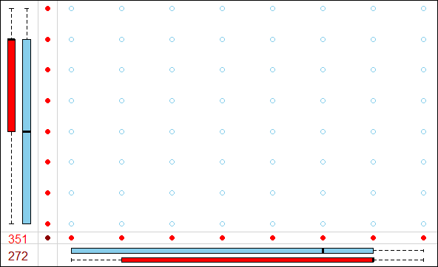
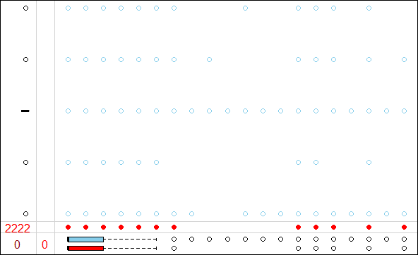
2. Data Imputation - Handling Missing Data

Slide 15
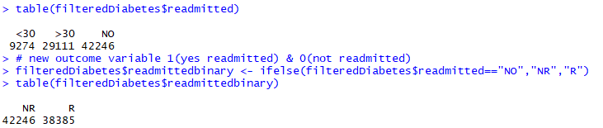
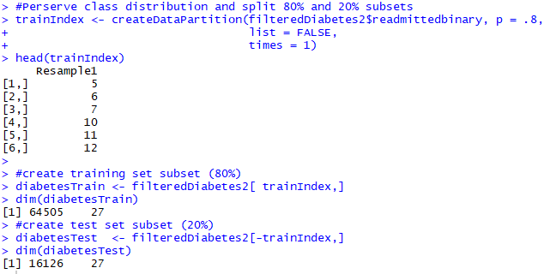
3. Model Planning
Outcome Variable:
R=> Readmitted, NR=> Not Readmitted (2 levels)
Test
Train
Split

Slide 16
4. Model Building
Up Sampling
Logistic Regression
Down Sampling
Smote Sampling
Models Used
Up Sampling
Decision Tree
Down Sampling
Smote Sampling

Slide 17
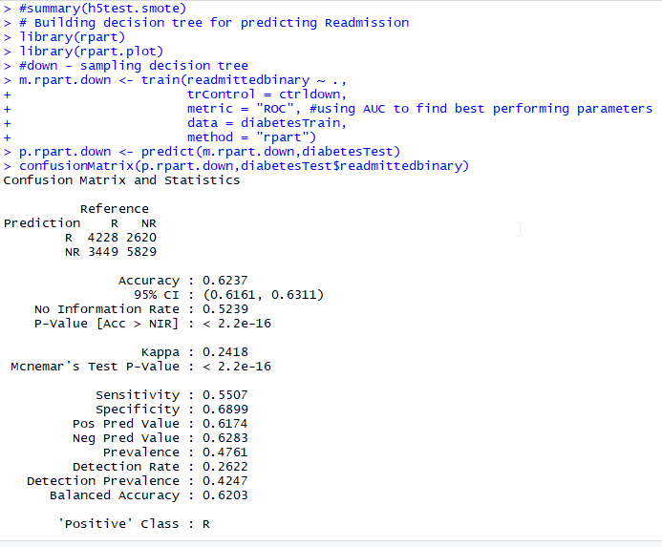
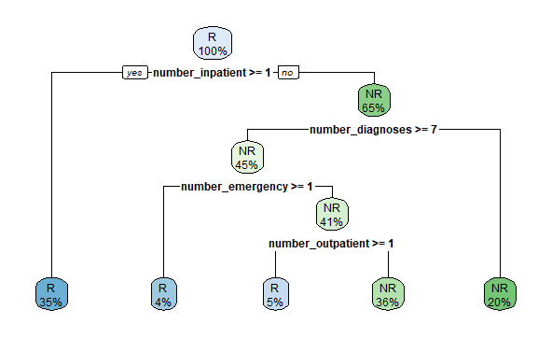
a. Decision Tree Confusion Matrix
R plot

Slide 18
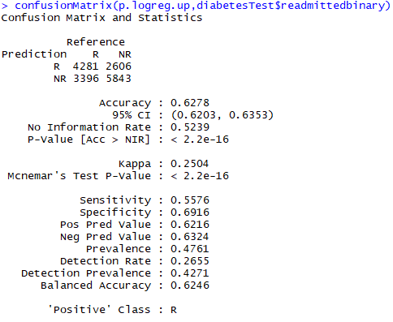
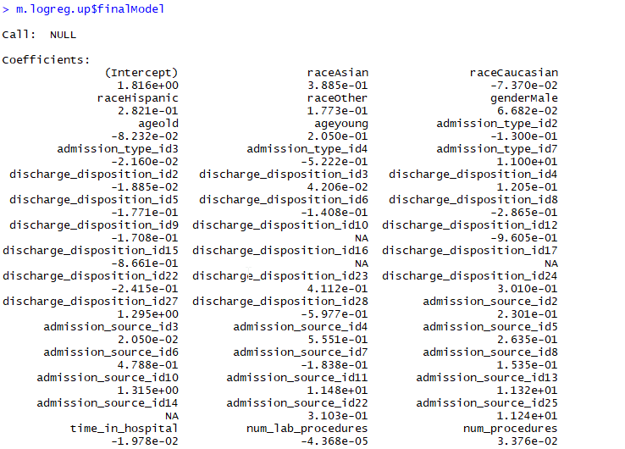
b. Logistic Regression
Confusion Matrix Model Coefficients

Slide 19
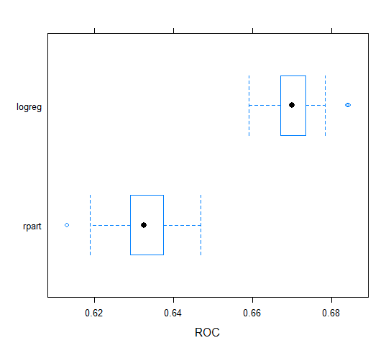
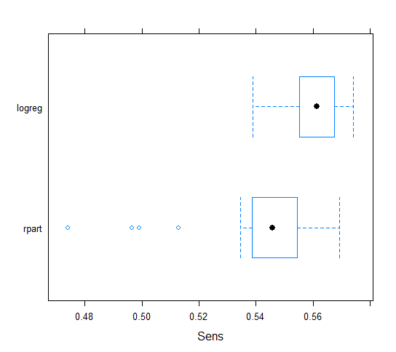
5. Model Evaluation
ROC Sensitivity

Slide 20
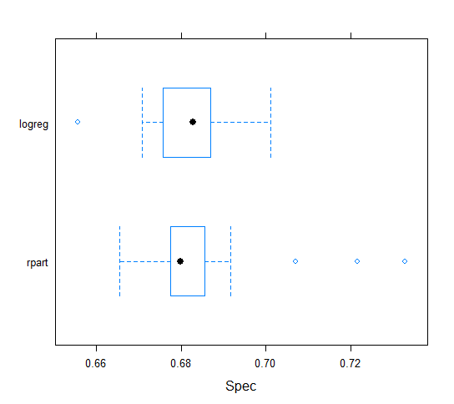
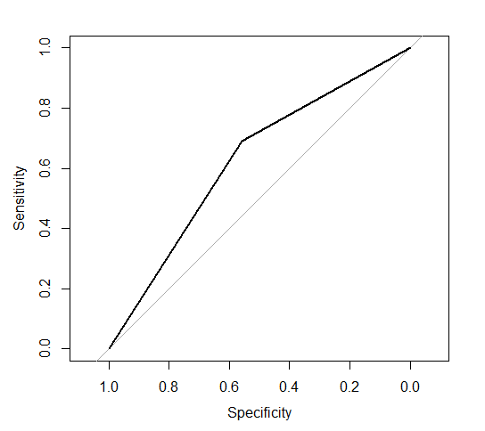

Specificity Logistic Regression - ROC Curve
Area under Curve = 0.6239
AUC Score

Slide 21
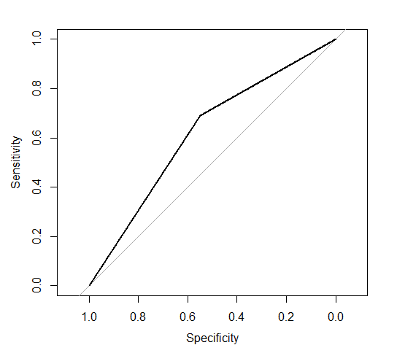
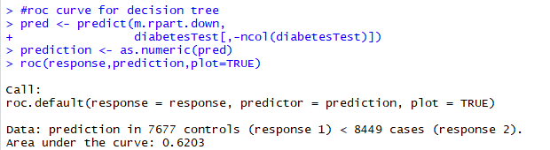
ROC Curve- Decision Tree
Area under Curve

Slide 22

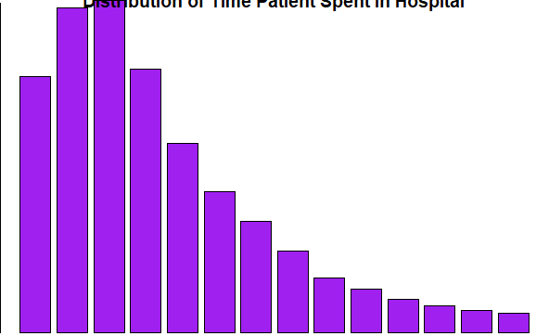
6. Visualization -boxplot

Slide 23
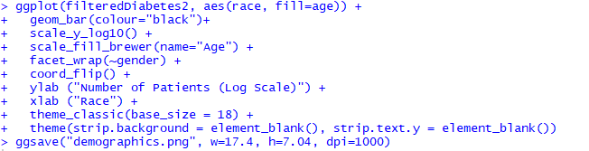
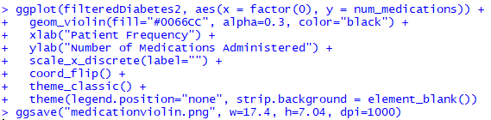
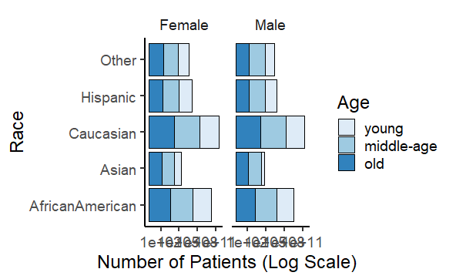
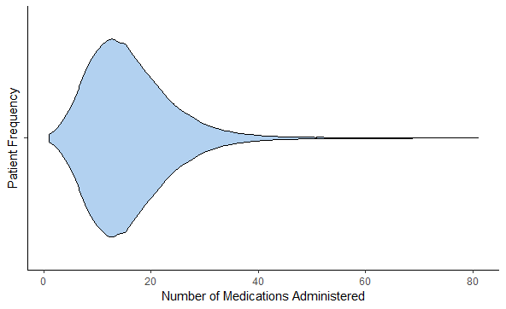
Visualization-ggplot

Slide 24
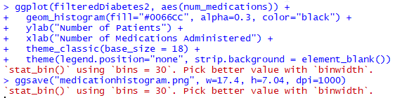
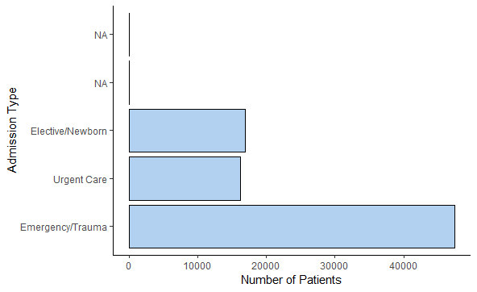
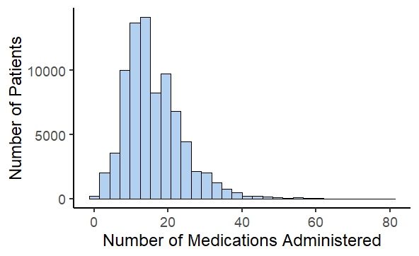
Visualization-ggplot

Slide 25
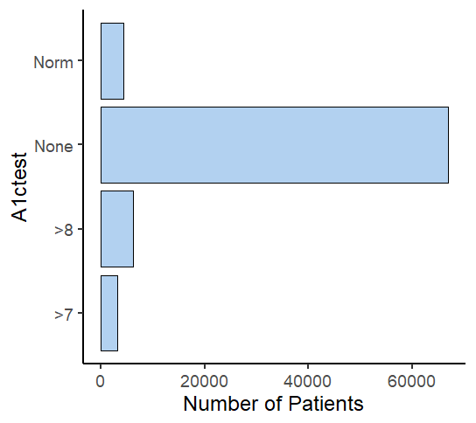
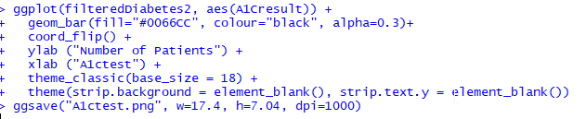
Data Visualization-ggplot
Code Plot

Slide 26
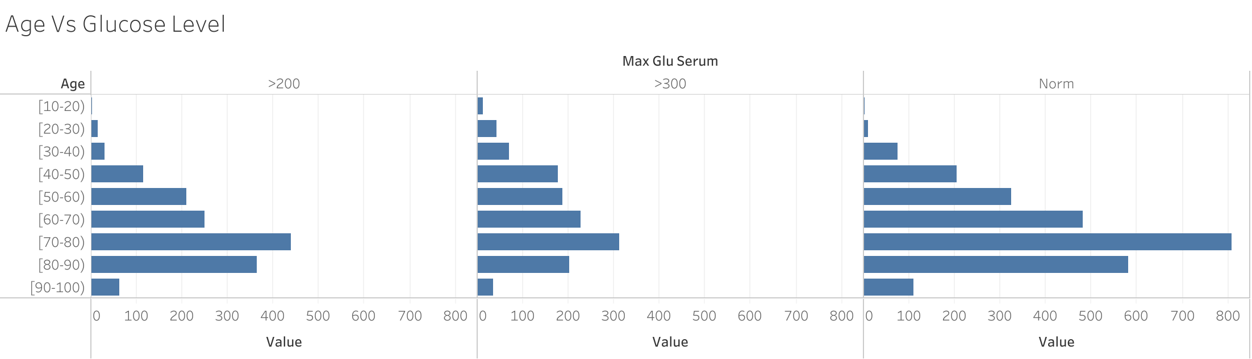
Data Visualization - Tableau

Slide 27
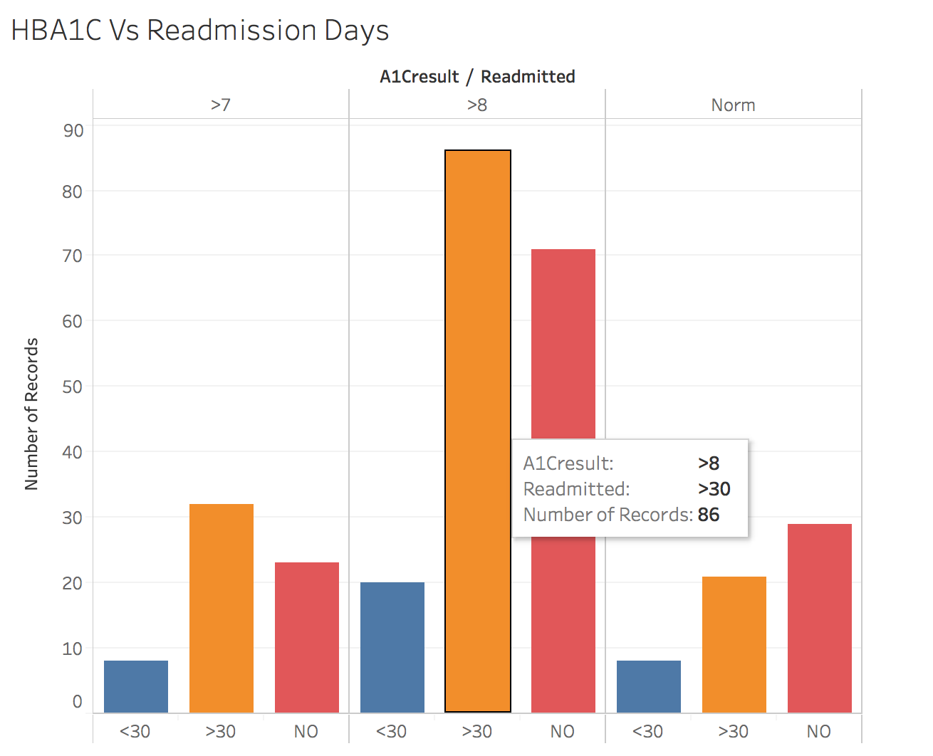
Data Visualization - Tableau

Slide 28
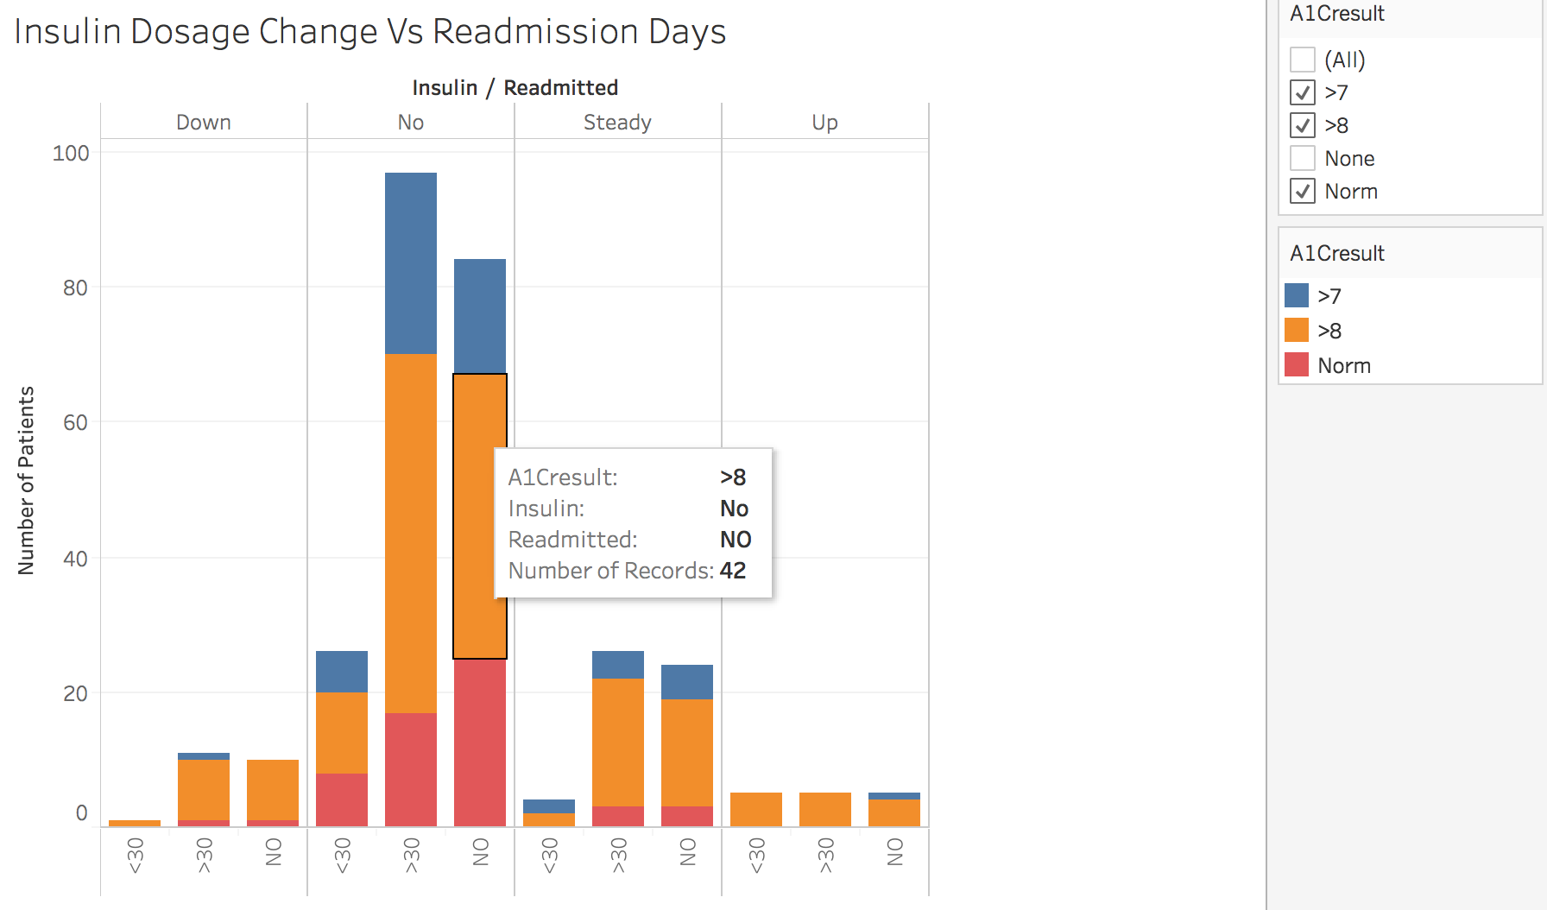
Data Visualization - Tableau

Slide 29
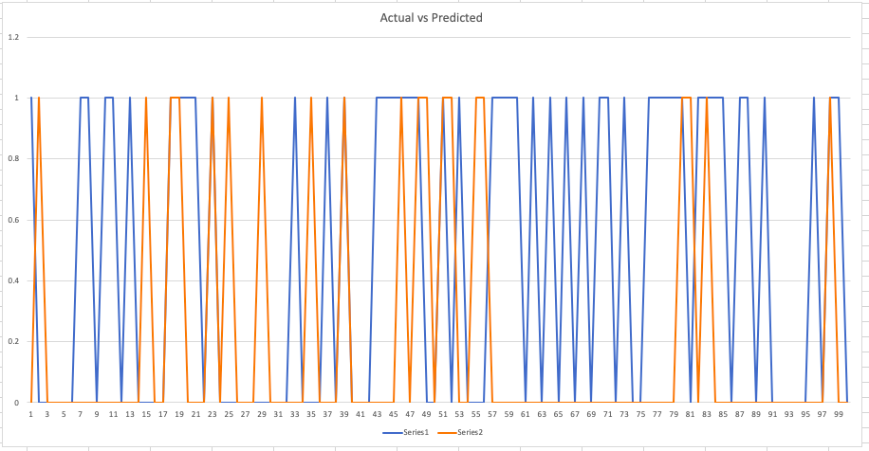
Data Visualization - Graph - Excel
Decision Tree - Prediction - Top 100 records - Actual vs Predicted data
Readmitted = 0
Not Readmitted = 1
Series 1 - Actual Series 2- Predicted

Slide 30
References
https://archive.ics.uci.edu/ml/datasets/diabetes+130-us+hospitals+for+years+1999-2008
https://github.com/chihwaro/predicting-readmission

